Slide 1
The Scientific Method
Notes – Day 2

Slide 2
6 Steps of the Scientific Method
1. Pose a question – Ask a test-able question about something.

Slide 3
2. Form a hypothesis – make an educated guess based on facts.

Slide 4
3. Design an experiment – you must have specific steps and all materials.

Slide 5
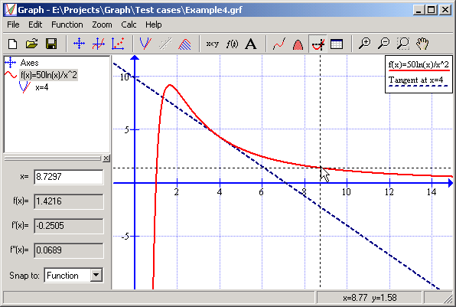
4. Collect and Analyze Data – Record and graph all facts.

Slide 6
5. Make a conclusion – Use your data to reject or accept your hypothesis.

Slide 7
6. Communicate your results – tell the world if your hypothesis was correct or not.

